Slide 1


Identity governance and administration for bank xyz
IT Service Group Assignment
FadhilLaH - Faisal –Hendri
COMP8031 - IT SERVICES
BGP - MTI

Slide 2

Content
Introduction
Study Case: 26th largest bank in Europe
Problem Statement
Facts and Number on Security breaches
Identity Theft is alarming
Current Challenges
Identity Governance and Administration (IGA) Solution

Slide 3

Bank XYZ
Bank XYZ is the 26th largest bank in Europe, serving retail, private and corporate banking clients primarily in the Netherlands, with select international operations.
It is the third largest bank in the European country, and they are focused on creating long-term value for stakeholders.

Slide 4
Problem statement
Legacy & Homegrown Solutions Slow Innovation and Compliance
A few years ago, employees at Bank XYZ who needed new access had to send an email to IT requesting that access. Because departments had different access policies, IT had to manually respond to each request after reviewing a myriad of options.
“We have 4,000 departments at Bank XYZ, which gives you an idea of the volume and number of ways IT was left interpreting requests for employee access,” said JRU, Product Owner at Bank XYZ.
The email-based request application was eventually deemed “the most hated tool,” and de Ru knew there had to be a more efficient, accurate and secure method for employees to request and receive access. At the same time, IT needed the ability to have a single view into all identity data.

Slide 5
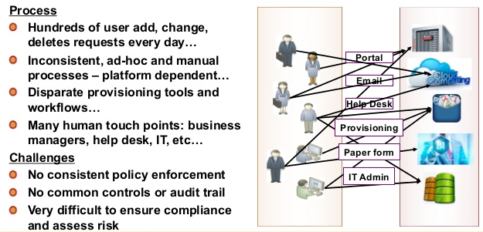
Current challenges

Slide 6
Identity Governance for Streamlined and Secure Access
To begin with, Bank XYZ built an identity strategy to streamline access to for their more than 30,000 users to over 200 applications.
Using HR data as the authoritative source, they now assign roles based on the employee’s department and corporate policy.
With IGA, Bank XYZ certifies access at the manager level, providing an audit trail of access approvals. de Ru has led the team by taking incremental steps and showing progress at each stage to win over new adopters.
“We’re taking on a significant effort to modernize our identity processes but need to be realistic along the way. Taking a phased approach helps us understand what’s working and what’s not, iterate, and then continue moving forward.”

Slide 7
FRAMEWORK
IDENTITY GOVERNANCE AND ADMINISTRATION (IGA)
IDENTITY AND ACCESS MANAGEMENT (IBM)

Slide 8
IDENTITY ACCESS MANAGEMENT

Slide 9
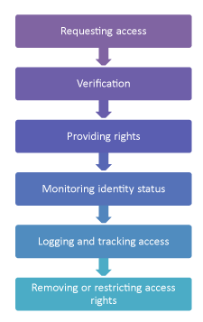
Process Activities of IDENTITY Access Management
Access is the extent of a service’s or asset’s functionality that a particular user is authorized to use.
Identity access management is the process responsible for allowing only authorized users to access certain assets and IT services while preventing unauthorized users from accessing it.

Slide 10
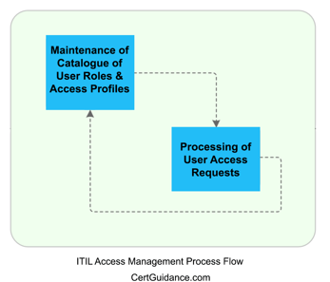
identity Access Management Sub-Process
1) Maintenance of Catalog of User Roles and Access Profiles:
This sub-process is responsible for building and maintaining an active repository (catalogue) of all the user roles and access profiles within an organization.
2) Processing of User Access Requests:
This sub-process is responsible for verifying the user, providing access rights, monitoring the identity status, removing or restricting access, and to log and track access.

Slide 11
Value of identity Access Management to Business
Access Management provides the following values to business
It ensures that by controlling the access to different IT services, the confidentiality of information will be maintained.
It ensures that the employees have only the required level of access to complete their jobs effectively.
It reduces the possibility of an error being induced in the use of a crucial service by not allowing unskilled users to access them.
It provides a means to audit the IT services and trace any misuse of the services.
It ensures that the access to the service to a particular user can be withdrawn when needed to comply with security requirements.

Slide 12
Identity Governance & Administration (IGA)

Slide 13
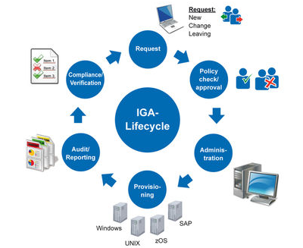

Slide 14
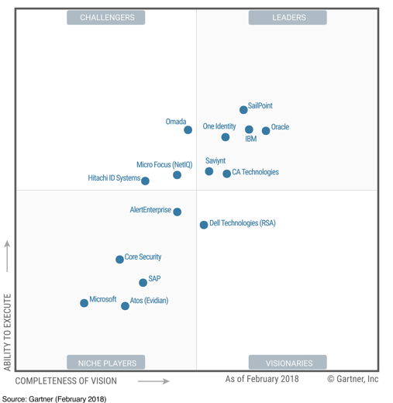







IGA Magic Quadrant

Slide 15
MAINTAIN AN ACCESS FOR IDENTITY GOVERNANCE

Slide 16

Enhancing identity assurance in a multi-perimeter world
If a North American worker suddenly uses her mobile device from Africa, the software notes an unusual change in context and may require the user to provide additional proof of identity, such as a one-time password. In some situations, the user may be denied access to certain IT resources because the security risk is deemed to be too high.

Slide 17
Integration with privileged identity management
• A check-out check-in mechanism that lets a privileged user check out an ID (with a password) for exclusive use and a limited time period
• A means for centrally provisioning and managing IDs on various resources
• Roles and policies for dictating which users have access to which IDs
• A process for users to request access to IDs and for managers to approve the requests
• Integrated audit logs that feed into a security intelligence solution to record all check-out check-in activities

Slide 18
Integration with identity intelligence
Organizations can combine output with log events and network flow data to develop “identity context aware” security intelligence

Slide 19
Reducing risks through governance
Planning for an identity and access governance strategy
Defining standards, processes, and controls for identity and access governance
Enabling the implementation of identity and access governance
Monitoring, measuring, and reporting on the effectiveness of the identity and access governance program.

Slide 20

Thank you
FADHILLAH - Faisal – hendri
Binus graduate program – mti - 2018

